Slide 1



Advanced R Data Analysis Training
Trainer : Saranya Ravikumar
Website:www.tertiarycourses.com.sg
Email: enquiry@tertiaryinfotech.com

Slide 2

About the Trainer
Saranya Ravikumar, has Masters of Engineering in Computer Science and Engineering who worked as an Assistant Professor in a reputed Engineering College at India. She is a Dell Emc certified Data Analyst. With a passion for teaching, she has more than 4 years of experience as an Assistant professor in Engineering Colleges. Also, she has more than 2 years of experience in leveraging the technical concepts through effective lectures in order to make the listeners gain the practical knowledge on the technical concepts of R, Python and Data Analytics using R.

Slide 3
Agenda
Module 1: R Data Analysis Packages
- Data Analysis Components
- Data Analysis Steps
- R Data Analysis Packages (including tidyverse)
Module 2: Obtaining Data
- Reading Data from CSV file
- Reading Data from JSON file
- Reading Data from XML file
- Reading Data from Web

Slide 4
Agenda
Module 3: Data Exploration and Cleaning
- Exploring data
- Imputing missing data
- Dealing with Outliers
Module 4: Data Preprocessing
- Selecting columns and rows
- Creating calculated columns
- Counting and arranging data
- Chain operations
- Joins
- Summarize and group by

Slide 5
Agenda
Module 5: Data Reshaping
- Splitting and merging columns
- Rearranging and reorienting columns
Module 6: Data Visualization
- ggplot2 syntax and analysis
Module 7: Tidying Models
- broom functions
- plotting models with ggplot2
Module 8: Advanced Analysis (optional)
- Map function
- User defined functions & logical testing
- pmap function

Slide 6
Prerequisite
Basic knowledge of R is assumed
Notes:
http://www.tkdocs.com/tutorial/install.html#installwin

Slide 7
Exercise Files
Download the exercise file from
https://github.com/SaranyaRavikumar06/Advance-R
Notes:
http://www.tkdocs.com/tutorial/install.html#installwin

Slide 8
Module 1
Getting Started

Slide 9
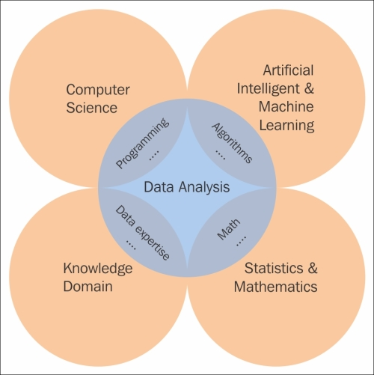

Slide 10
Data Analysis Steps
Data Collection
Data Processing
Data Cleaning
Data Visualization
Data Product

Slide 11
R Data Analysis Packages
Data Manipulation
dplyr: Data manipulation tasks
tidyr: Reshape data
mice: Missing data Imputation
Data Analysis
DataExplorer: Visualize variables

Slide 12
R Data Analysis Packages
Data Visualization
ggplot2: Powerful visualization
shiny: Interactive data visualization
VIM: Missing data visualization

Slide 13
Install Packages
install.packages("tidyverse")
install.packages("DataExplorer")
install.packages("data.table")
install.packages("mice")
install.packages("VIM")
install.packages("broom")

Slide 14
Module 2
Obtaining Data

Slide 15
Read Data from CSV File
data1 <- read.csv ("data.csv", header=TRUE)

Slide 16
Read Data from json
library(jsonlite)
data <- fromJSON(“data.json”)

Slide 17
Read Data from XML
library(XML)
data <- xmlTreeParse(data.xml)

Slide 18
Read Data from Web
url<-"http://archive.ics.uci.edu/ml/machine-learning-databases/wine/wine.data"
read.csv(url, nrows=5, header = FALSE)

Slide 19
Challenge
Read the housing data from the following webpage
“https://archive.ics.uci.edu/ml/machine-learning-databases/housing/housing.data”
and store it in a dataframe named house
Time: 5 min

Slide 20
Module 3
Data Exploration and Cleaning

Slide 21
Exploring our data
# load our library
library(DataExplorer)
library(data.table)
## explore our dataset
names(heart)
head(heart)
str(heart)
summary(heart)
## changing our data type
heartDT<-data.table(heart)

Slide 22
Exploring our data
# grouping and frequency analysis
group_category(heartDT, "ChestPain", 0)
# view frequency based on another measure
group_category(heartDT, "ChestPain", 0, "Age")

Slide 23
Plotting
#discrete features (categorical data)
plot_bar(heartDT)
# continous features (numeric data)
plot_boxplot(heartDT, by="AHD")
# AHD is the categorical var
# correlation plot
plot_correlation(heartDT)

Slide 24
Plotting
# density plot
plot_density(heartDT)
# only for numerical columns
# histogram
plot_histogram(heartDT)
# only for numeric columns
# scatterplot
plot_scatterplot(heartDT,"Age")
# using age as y axis

Slide 25
Splitting data
# will generate 2 data tables for continuous and discrete data
output<-split_columns(heartDT)
output$discrete
output$continuous

Slide 26
Imputing data
library(mice)
library(VIM)
# Visualization of the missing pattern
aggr(miss_mtcars, numbers=TRUE)
# Mean Substitution
mean_sub <- miss_mtcars
mean_sub$qsec[is.na(mean_sub$qsec)] <- mean(mean_sub$qsec, na.rm = TRUE)

Slide 27
Dealing with Outliers
# ESD method
t=2
m=mean(x)
s=sd(x)
b1=m - s*t
b2=m + s*t
y=ifelse(x >=b1 & x <=b2, 0, 1)
table(y)

Slide 28
Dealing with Outliers
# boxplot method
boxplot(x)
boxplot.stats(x)
# outliers package
library(outliers)
dixon.test(x)

Slide 29
Challenge (10 mins)
Using the airquality dataset in R
1)explore the dataset
2)do frequency analysis
3)plot features and correlation plot
4)view the missing values
5) substitute the missing values with mean
6)remove any outliers * (Not as commonly done in statistics)

Slide 30
Module 4
Data Preprocessing

Slide 31
Data structure
glimpse(x)
lst(x)
tbl_sum(x)

Slide 32
Selecting columns
select(heart,Age,Sex,ChestPain,RestBP)
# selecting only 4 columns
select(heart,RestBP,Age,Sex,ChestPain)
# rearranging columns
select(heart, -Age,-Sex)
# dropping columns
rename(heart, "Gender"=Sex)
# renaming column

Slide 33
Filtering rows
filter(heart, ChestPain==”typical”)
# filter only typical ChestPain rows
filter(heart, ChestPain==”typical” & Age>65)
# double condition filtering
filter(heart, ChestPain %in% c(“asymptomatic”,”nonanginal”))
# only retain 2 types of ChestPain
filter(heart, row_number()<=20)
slice(heart, 1:20)
#select first 20 rows

Slide 34
Creating calculated columns
mutate(heart, Old = Age>50)
# this will give a new column with TRUE or FALSE
mutate(heart, CholClass=Chol/20)
mutate(heart, CholClass=Chol/20,
HighRestBP=RestBP>140)
# this will give two new columns

Slide 35
Creating calculated columns
# using if_else function in mutate
mutate(heart,
CholLevel= if_else(Chol>250,"highrisk","normal")))

Slide 36
Counting and arranging
count(heart, ChestPain, sort = TRUE)
count(heart, AHD, sort=TRUE)
count(heart, ChestPain, AHD)
distinct(heart,ChestPain) #gives 4 levels
distinct(heart,ChestPain,AHD) #distinct combinations of 2 variables

Slide 37
Counting and arranging
arrange(heart, Age)
# arrange all the rows by Age
arrange(heart, Age, Thal)
# arrange by Age first then Thal
arrange(heart, desc(Age))
# descending order
top_n(heart, 5, Age)
#top 5 rows with respect to Age (use -5 for bottom rows.

Slide 38
Chaining
# the “%>%” is used in chain operations
# link one process to another
heart %>%
select(1:5) %>%
mutate(Old=Age>50) %>%
filter(Old==TRUE & ChestPain=="typical")%>%
arrange(-Age)

Slide 39
Joins
left_join(A,B, by="col1")
#join matching rows from B to A
right_join(A,B, by="col1")
# join matching rows from A to B
inner_join(A,B, by="col1")
# join data, retain only rows common in both sets)
full_join(A,B, by="col1")
# join data, retain all values, all rows)

Slide 40
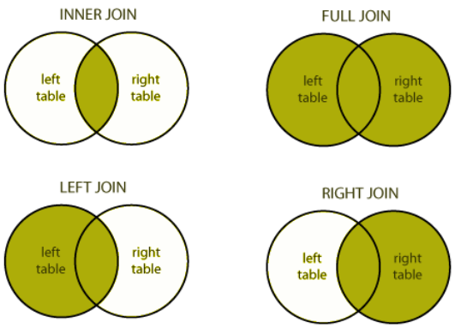
Helpful Diagrams for Join Operations

Slide 41
Group by
group_by(heart, ChestPain)
# ChestPain is the variable which we want to create groups ["typical", "asymptomatic", ”nonanginal”, “nontypical”]
group_by(heart, ChestPain, Sex)
# Group by more categorical variables.

Slide 42
Summarize
# create your own summary statistics
summarize(heart,
count=n(),
avgAge=mean(Age, na.rm=TRUE),
sdAge=sd(Age, na.rm=TRUE),
medAge=median(Age, na.rm=T),
Q3rdAge=quantile(Age, .75))
# summary by group
summarize(group_by(heart,ChestPain),
count=n(),
avgAge=mean(Age,na.rm=TRUE))

Slide 43
Challenge (10 mins)
Use the mtcars dataset
Select first 9 columns and 20 rows
Create calculated column for average of
Mpg and Disp
Arrange by qsec in descending order
Group by cyl and vs
Do summary stats like (count, mean, max) for mpg

Slide 44
Module 5
Data Reshaping

Slide 45
Separate
# if your data contains 2 sets of information in 1 column you can split them up
Arguments
#first: dataset name,
#second: column Name to split,
#third: new col names to split column into (names)
#fourth: the separator (what split the columns by)
separate(team, HomeTown, c("City", "State"), sep=",")

Slide 46
Unite
#opposite of separate, combining columns
Arguments
#first: dataset name,
#second: column Name to unite columns into,
#third: column names to combine
#fourth: the separator in the new columns
unite(team, "Full Name", c(First_Name, Last_Name), sep=" ")

Slide 47
Challenge (2 mins)
Task: use data heart
Unite Sex & ChestPain by "_" separator

Slide 48
Gather
# rearranging and re-orienting the columns by stacking them into a single column.
#first: dataset name,
#second: new column name (for columns we are stacking into),
# third: new column names (for values of the stacked columns)
#fourth: columns that we are stacking
homeruns2<-gather(homeruns, year, home_runs, YR2015:YR2013)

Slide 49
Spread
#opposite of gather, spreading out the columns
# first: dataset name,
# second: column to spread across multiple column,
# third: values multiple columns will take
spread(homeruns2, year, home_runs)

Slide 50
Module 6
Data Visualization

Slide 51
ggplot2
Grammar of graphics:
data + geoms + coordinate system
ggplot(data, aes(x=..,y=..,color=..,shape=.. )) +
geom_*(aes(...), ...) +
stat_*(aes(...), …) +
Additional elements….
aes(): map variables in data to aesthetic properties of the geom, like x, y, color, size.

Slide 52
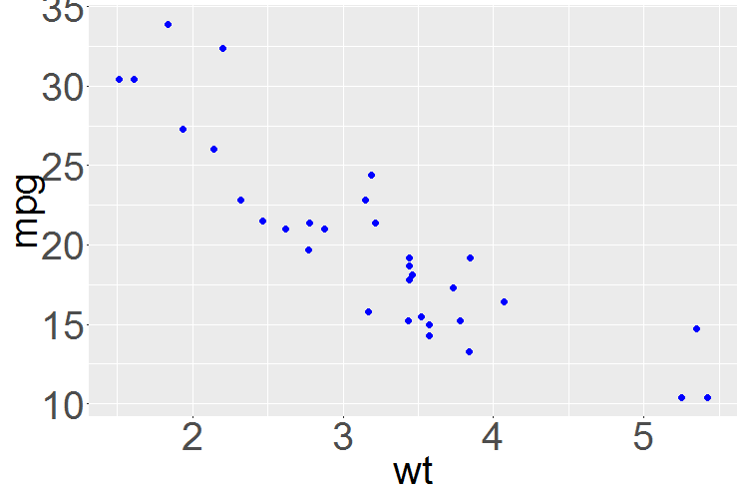
Scatter Plot
ggplot(mtcars) + aes(x=wt, y=mpg) + geom_point(size=3, color = “blue”)

Slide 53
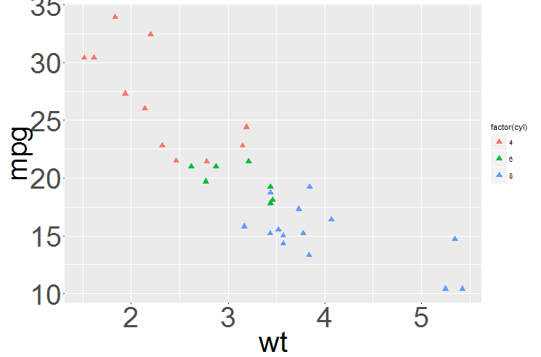
Scatter Plot (grouped data)
ggplot(mtcars) + aes(x=wt, y=mpg, color = factor(cyl) ) + geom_point(size=3)

Slide 54
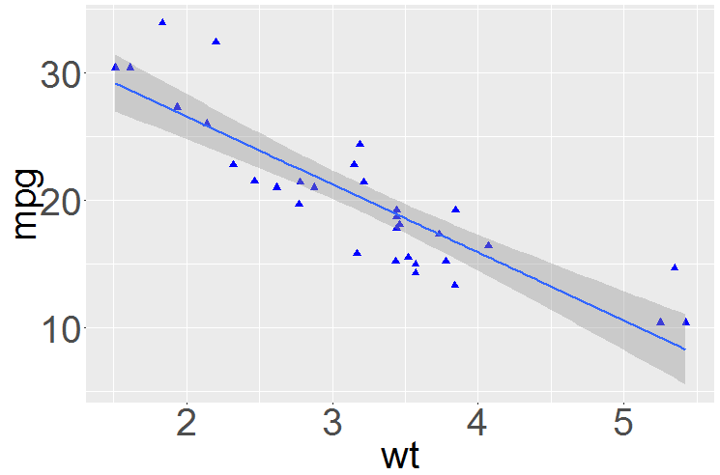
Scatter Plot (adding a trendline)
ggplot(mtcars) + aes(x=wt, y=mpg) +
geom_point() + stat_smooth(method = "lm")

Slide 55
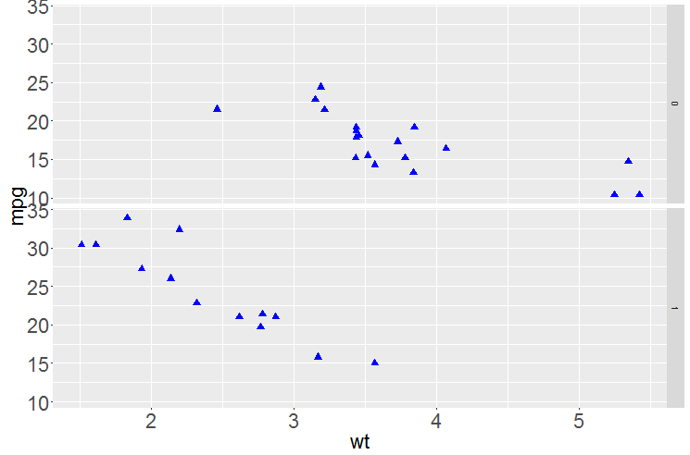
Scatter Plot (facetting: I)
ggplot(mtcars) + aes(x=wt, y=mpg) +
geom_point() + facet_grid( am ~ . )

Slide 56
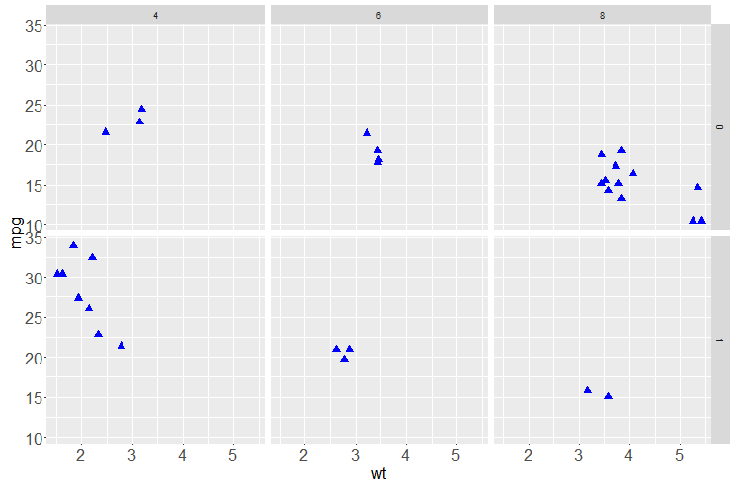
Scatter Plot (facetting: II)
ggplot(mtcars) + aes(x=wt, y=mpg) +
geom_point() + facet_grid( am ~ cyl)

Slide 57
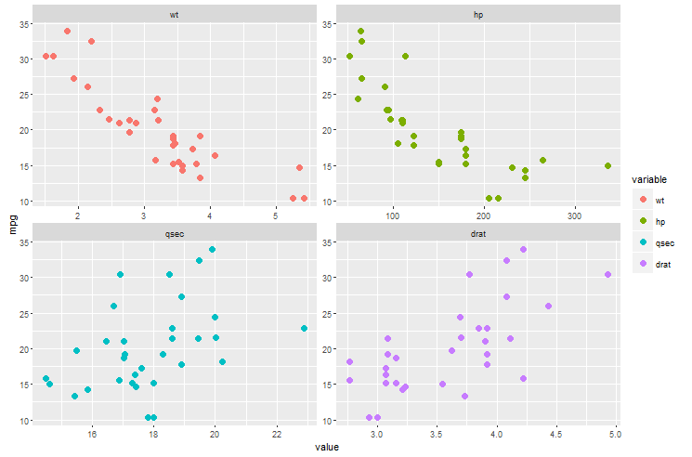
Scatter Plot (facetting: III)
data<-gather(mtcars, variable, value, c(wt, hp, qsec, drat), factor_key=TRUE)
ggplot(data) + aes(x=value, y = mpg, color=variable) + geom_point() + facet_wrap( ~variable, scales = "free", ncol = 2)

Slide 58
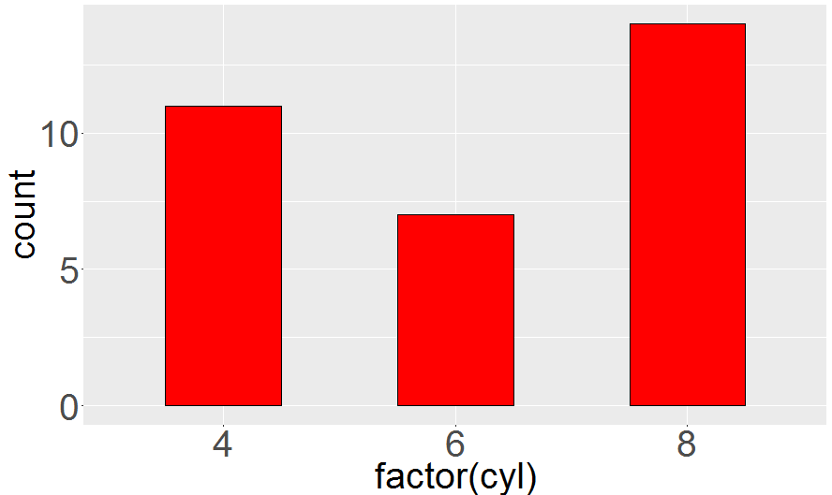
Bar Plot
ggplot(mtcars, aes(x = factor(cyl))) + geom_bar(fill="red",color="black")

Slide 59
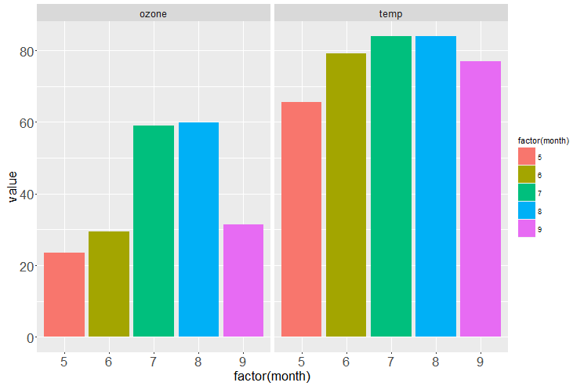
Multiple Bar Plot
data<-gather(airquality, variable, value,
c(Ozone,Temp), factor_key=TRUE)
ggplot(data,aes(x=factor(Month),y=value,fill=factor(Month)))+geom_bar(stat = "summary", fun.y = "mean")+facet_grid(~variable)

Slide 60
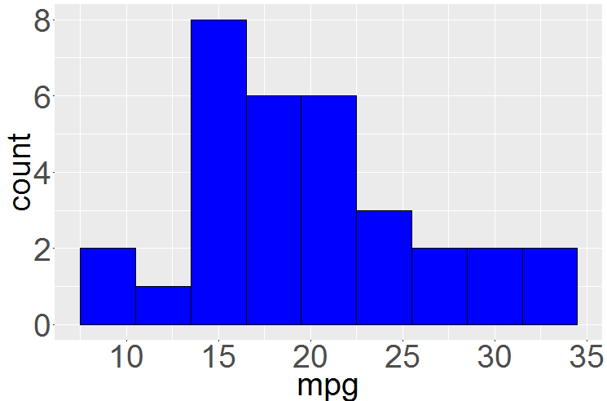
Histogram
ggplot(mtcars, aes(x = mpg)) + geom_histogram(binwidth = 3, fill="blue",color="black")

Slide 61
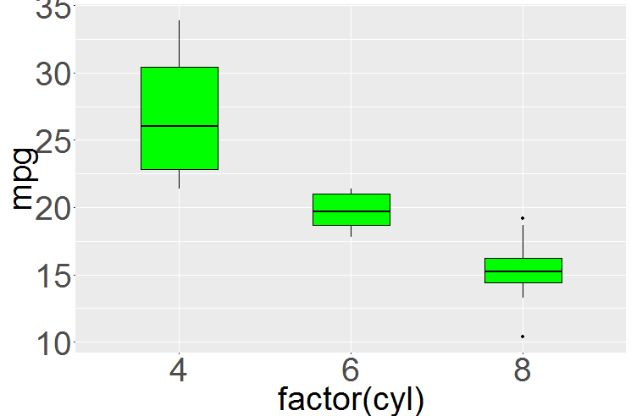
Boxplot
ggplot(mtcars, aes(x = factor(cyl), y = mpg)) + geom_boxplot(fill="green")

Slide 62
Save the plot
#save the last plot to file
ggsave("plotname.png", width=5, height=5)

Slide 63
Challenge
Use the airquality dataset
Plot Ozone vs Day
Use different colors for different months
Use different panels for different months
Save the plot

Slide 64
Module 7
Tidying models with broom

Slide 65
Intro to broom package
Converts models created in R into data frames and tidy format for easy manipulation with dplyr and plotting with ggplot2.
Summarizes key information about statistical objects in tidy tibbles. This makes it easy to report results, create plots and consistently work with large numbers of models at once.
There are only 3 functions:
tidy()
augment()
glance()

Slide 66
Intro to broom package
tidy( ) > constructs a dataframe that fits the models's findings
augment() > adds columns to the original data that was modelled
including predictions, residuals and cluster assignments
glance() > constructs a concise one-row summary of the model

Slide 67
The 3 Functions in detail
Broom provides three functions that each provide different types of information about a model.
tidy() summarizes information about model components such as coefficients of a regression.
glance() reports information about an entire model, such as goodness of fit measures like AIC and BIC.
augment() adds information about individual observations to a dataset, such as fitted values or influence measures.

Slide 68
Linear Regression with broom
lmFit<-lm(mpg~wt, data=mtcars)
myTidyModel<-tidy(lmFit, conf.int=TRUE)
# put conf.int=TRUE is optional
myTidyModel$p.value
augment(lmFit)
glance(lmFit)

Slide 69
Plotting broom data frame
Using ggplot2 to plot the model coefficients
ggplot(myTidyModel, aes(estimate, term, color=term)) +
geom_point() +
geom_errorbarh(aes(xmin=conf.low, xmax=conf.high))

Slide 70
Challenge
Create a linear regression model with the airquality dataset (Temp~Ozone)
Use the broom functions and plot the graph with ggplot2

Slide 71
Module 8
Advanced Analysis
(optional)

Slide 72
Map functions
library(purrr)
# map() returns a list or dataframe
# map_lgl() returns a logical vector
# map_int() returns a integer value
# map_dbl() returns a double vector
# map_chr() returns a character vector

Slide 73
Map functions
map(x, summary) # find a summary of each column
map_lgl(x, is.numeric) # find columns that are numeric (return logical)
map_chr(x, typeof) # find the type of each column (return character)

Slide 74
Apply functions
map_dbl(x, mean) # find column means
map_dbl(x, sd) # find column std dev
map_dbl(x, quantile, probs=c(0.05)) # find 5th percentile

Slide 75
Apply user-defined functions
# group the heart ChestPain types
# nest function to convert to tibble
n_heart <- heart %>%
group_by(ChestPain) %>%
nest()

Slide 76
Apply user-defined functions
# create a model for each ChestPain
mod_fun<-function(x) {lm(Chol~ Age + RestBP + Thal, data=x)}
# apply the model
model_heart<-n_heart %>% mutate(model=map(data, mod_fun))
# use "data" to symbolize the data

Slide 77
Logical testing
pluck(heart, "Age") # get values in "Age"
old=function(x){x>50}
keep(heart$Age, old) # keep elements that pass a logical test
discard(heart$Age, old) # remove elements that pass a logical test

Slide 78
Summarize data
every(heart$Age, old)
# do all elements pass a test
some(heart$Age, old)
# do some elements pass a test
detect(heart$Age, old)
# find first element that pass a test
detect_index(heart$Age, old)

Slide 79
pmap
# pmap takes a list of arguments as input
# using multiple arguments with map
n=list(5,10,20)
mu=list(1,5,10)
sd=list(0.1,1,0.1)
pmap(list(n, mu, sd), rnorm)

Slide 80
Challenge (10 mins)
Use the mtcars dataset
Map summary of each column
Find column means
Group by cyl and am (nest)
Apply a model for each group

Slide 81

Summary
Q&A

Slide 82

Feedback
https://goo.gl/R2eumq

Slide 83
Thank You!
Saranya Ravikumar
saranyaviji1987@gmail.com

